Slide 1
Understanding Feature Extraction with HOG
Presented by: Muhammad Zaqeem

Slide 2
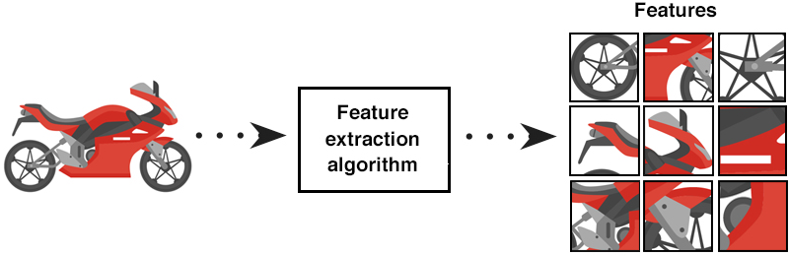
Feature Extraction
Feature Extraction is the process of transforming raw data (like images, text, or sound) into a set of features that can be used for further analysis.
feature extraction focuses on identifying and capturing the most important, informative parts of the data, often simplifying the dataset for more effective learning and classification.
Raw data, especially from images or text, can be huge and difficult to process. By reducing the data to relevant features, it’s easier and faster to train machine learning models.
Focusing on meaningful features helps models focus on important aspects of the data, leading to better performance.
Feature extraction helps in reducing the dimensionality of the data, which can improve the speed of learning algorithms and reduce overfitting.
Imagine you want a computer to recognize a cat in an image. Raw pixels from the image might contain unnecessary information, like background noise. By extracting features like edges, textures, or shapes of the cat’s body, the model can focus on these key parts of the image, leading to better classification.

Slide 3
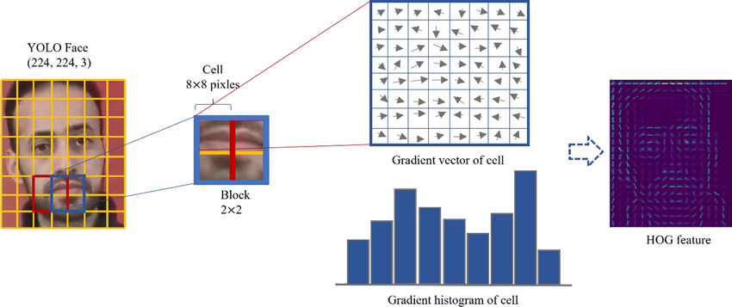
HOG (Histogram of Oriented Gradient)
HOG (Histogram of Oriented Gradients) is a popular and powerful feature extraction technique used primarily in computer vision and image processing.
It is commonly applied in tasks like object detection, face recognition, and human detection.
The core idea behind HOG is to capture the gradient information (i.e., edges and textures) in an image, which are important for understanding its structure and identifying objects within it.
HOG is a feature descriptor that counts occurrences of gradient orientation in localized portions of an image.
It divides the image into small regions called cells, computes a histogram of gradient directions within each cell, and then normalizes local contrast in overlapping blocks

Slide 4
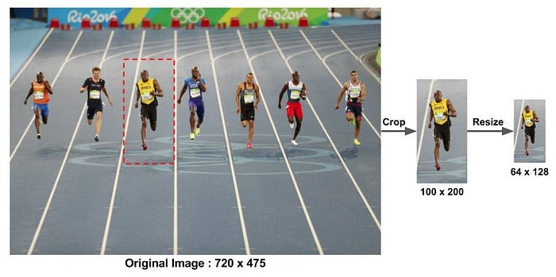
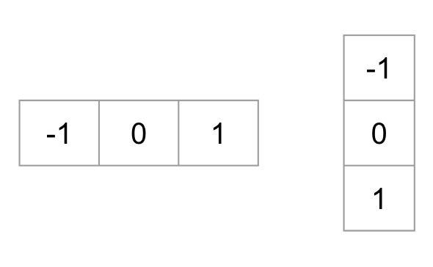
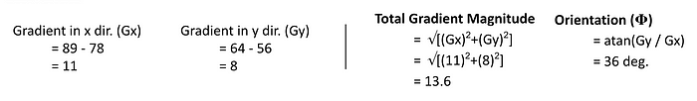
How HOG Works
Preprocess the Data: This is a step most of you will be pretty familiar with. Preprocessing data is a crucial step in any machine learning project and that’s no different when working with images
We need to preprocess the image and bring down the width to height ratio to 1:2. For a particular image that you choose, make sure that you identify the section that you want so that it correctly fits the aspect ratio and allows for easier accessibility in the long run.
Calculate Gradient & Orientation:
Compute the gradients for each pixel in the x and y directions using filters like Sobel operators. From these gradients, calculate the magnitude and orientation.
Total Gradient Magnitude = √[(G_{x})²+(G_{y})²]
Orientation = atan(Gy / Gx)
Divide the Image into Cells: The image is split into small grids called cells (e.g., 8x8 pixels). Gradients are processed for each cell separately.
Different Methods to Create Histograms using Gradients and Orientation: A histogram is a plot that shows the frequency distribution of a set of continuous data.
Method 1:
Let us start with the simplest way to generate histograms. We will take each pixel value, find the orientation of the pixel and update the frequency table.

Slide 5
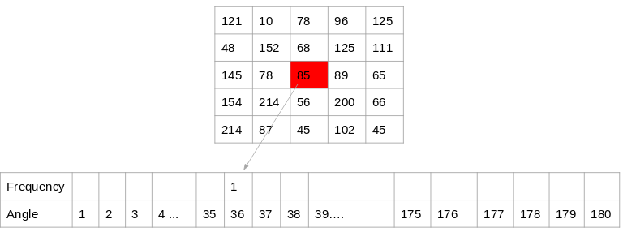
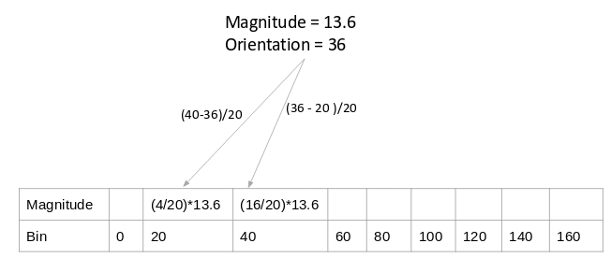
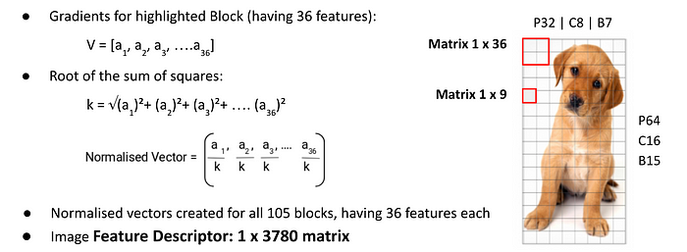
Here is the process for the highlighted pixel (85). Since the orientation for this pixel is 36, we will add a number against angle value 36, denoting the frequency:
Method 2:
Next up, let’s try to plot these gradient and orientation values on a histogram. Gradient and orientations values for our highlighted pixel are 13.6 and 36 degrees respectively. We already know that this orientation value may vary between 0 to 180 degrees. For the histogram, HOG prepares bins of 20 degrees each. So, there are 9 bins. Next up, HOG would start inserting gradient magnitude values as per the pixel orientation into these 9 bins.
Normalize gradients: To reduce the effect of lighting variations (for example, some parts of the image might be brighter than others), we normalize the histograms across a larger region. Instead of normalizing histograms for individual 8x8 cells, we group 4 adjacent 8x8 cells into a 16x16 block. The histograms of these cells are then concatenated into a single 36x1 vector.
Features for the Complete Image: After processing smaller 16x16 blocks, we combine all the histograms to form a final feature vector for the entire image. This vector can then be used for machine learning tasks like object detection
Suppose your image is 64x128 pixels.
After dividing the image into 16x16 blocks, you would get 105 blocks (7 blocks along the width and 15 along the height).
Each of these 105 blocks has a 36x1 feature vector.
Multiply the number of blocks by the size of the feature vector (105 * 36 = 3780 features).

